Slide 1


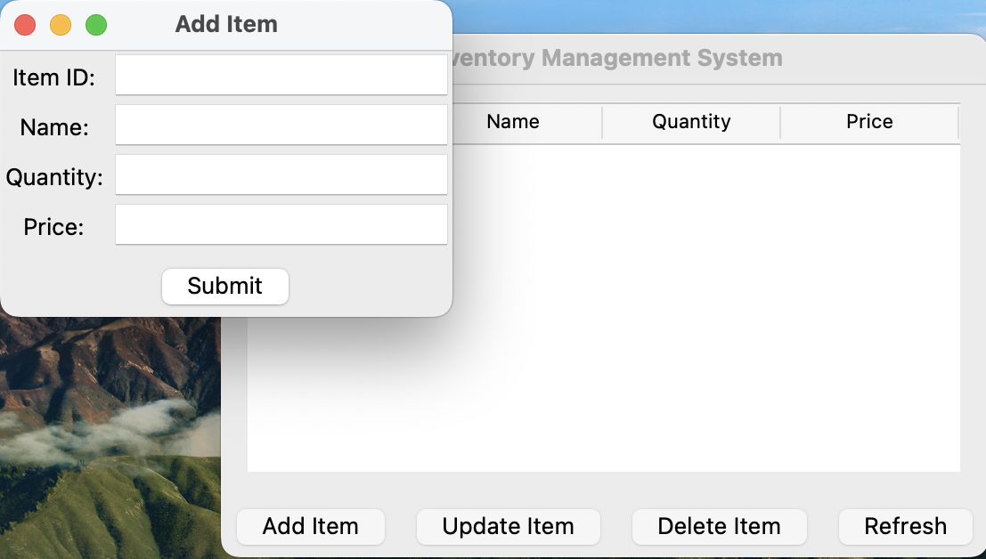


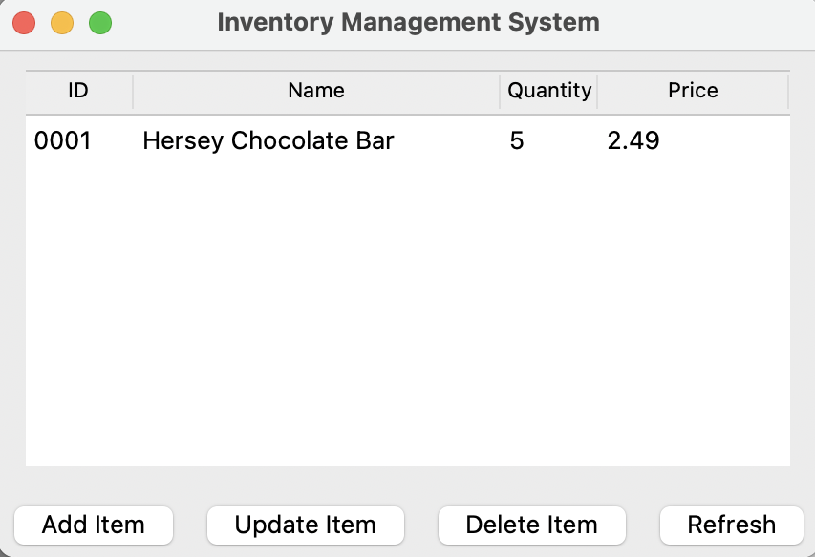
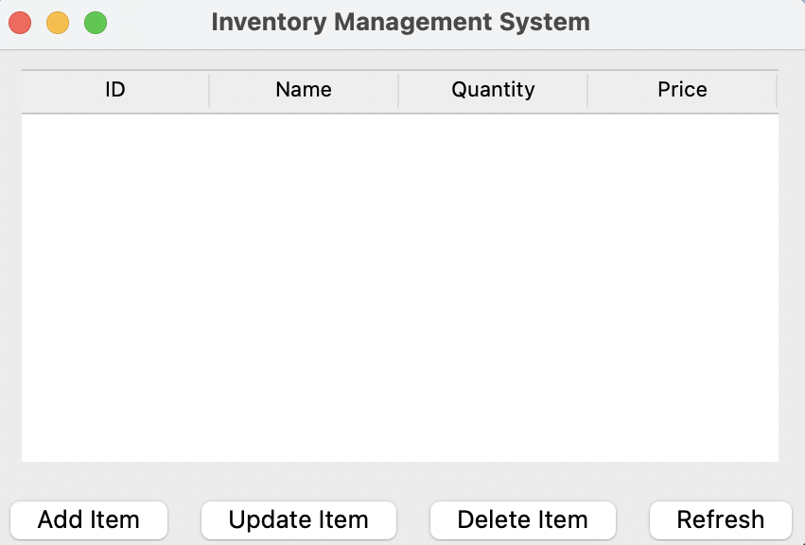

Inventory management system
This is a system designed to help small businesses to manage their inventory.
It will allow them to track and maintain stock. Insuring nothing is lost and business is maintained.
You can easily add and subtract items.
Update the system live and make any changes as you like.
Imported pandas so you make predictive analysis if you want to.

